Slide 1
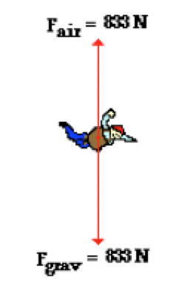
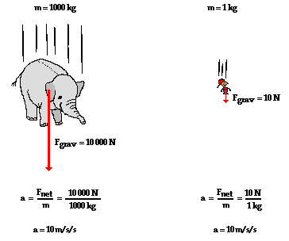
Acceleration due to Gravity
Inquiry questions
Assigning a “+” direction
Examples
Air Resistance
Does m affect g?
Terminal Speed
Practice

Slide 2
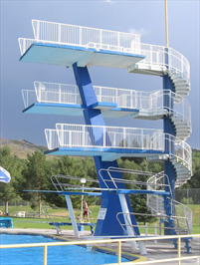
Which height will produce the greatest speed upon impact? Why?
The _________ diving board will produce the greatest speed for the diver upon impact because
10 m
7 m
5 m

Slide 3
Acceleration due to Gravity
The acceleration due to gravity (g) of any falling object is approximately 9.8 m/s² [downward]
True or False, g is dependent on where you are on Earth.
True or False, g changes as you move to different planets.

Slide 4
Acceleration due to Gravity
http://www.physicsclassroom.com/class/1DKin/Lesson-5/Acceleration-of-Gravity
True or False, g is dependent on where you are on Earth.
TRUE
The force of gravity increases as you near the center of mass therefore, lower altitude (closer to Earth’s core) = larger g. Also, Earth bulges at the equator therefore, g is larger at the poles.
True or False, g changes as you move to different planets.
TRUE
The force of gravity is dependent on mass, greater mass = larger g.

Slide 5
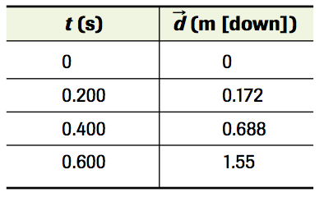
Check Your Understanding
A diver steps off a 10.0-m high diving board with an initial vertical velocity of zero and experiences an average acceleration of 9.80 m/s² [down]. Air resistance is negligible. Determine the diver’s velocity in metres per second and in kilometres per hour, after falling (a) 5.00 m and (b) 10.0 m.
The table to the bottom-right gives position-time data for a ball dropped vertically from rest.
Use the final data pair and the appropriate equation for constant acceleration to determine the acceleration.
If the value of the acceleration due to gravity in the place where the ball was dropped is 9.81 m/s2 [down], what is the percentage error of the experimental value?
Olympic events have been held at locations with very different altitudes. Should Olympic records for events, such as the shot put, be adjusted for this?

Slide 6
Check Your Understanding Solutions
a) 9.90 m/s [down];35.6 km/h [down] b) 14.0m/s[down]; 50.4 km/h [down]
a) 8.61 m/s2 [down] b) 12.2%

Slide 7
Assign a positive direction
It is important to use consistent directions with any single motion question. For an object experiencing only downward motion, it is convenient to choose downward as positive.
If an object is thrown upward or if it bounces upward after falling downward, either upward or downward can be called positive.
The important thing is to define your choice for the positive y direction and to use that choice throughout the entire solution.

Slide 8
Check Your Understanding

Slide 9
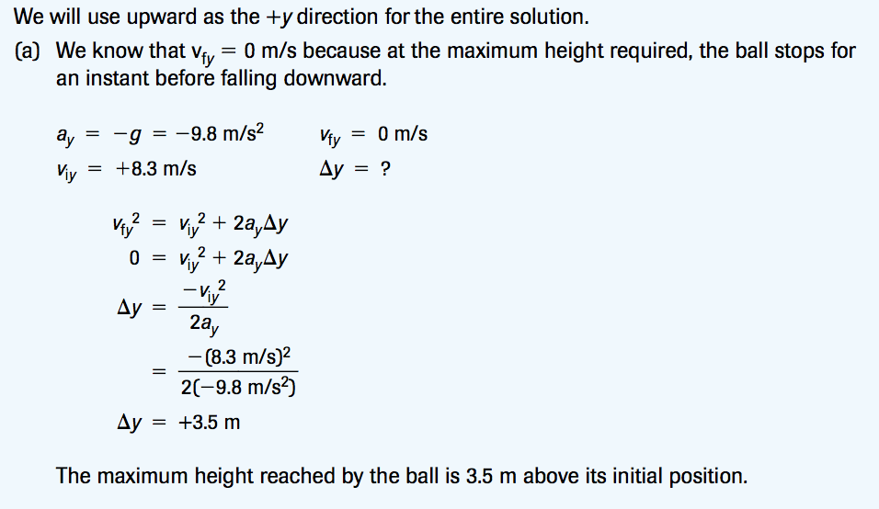
Check Your Understanding - Solutions

Slide 10
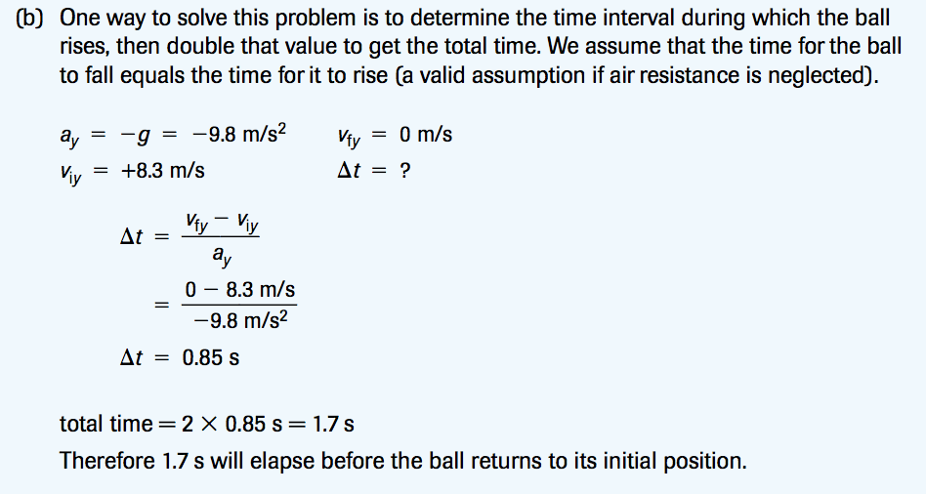
Check Your Understanding - Solutions

Slide 11
Check Your Understanding
An arrow is shot vertically upward beside a building 56 m high. The initial velocity of the arrow is 37 m/s [up]. Air resistance is negligible. At what times does the arrow pass the top of the building on its way up and down?
Define your givens, unknown and equation:

Slide 12
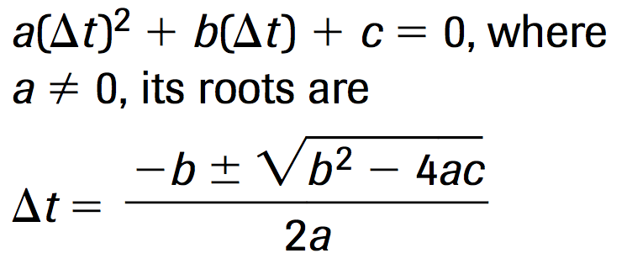
Check Your Understanding
How do you solve for t?
We need to use the Quadratic Formula
Rearrange your equation and substitute in your variables
Solve for t

Slide 13
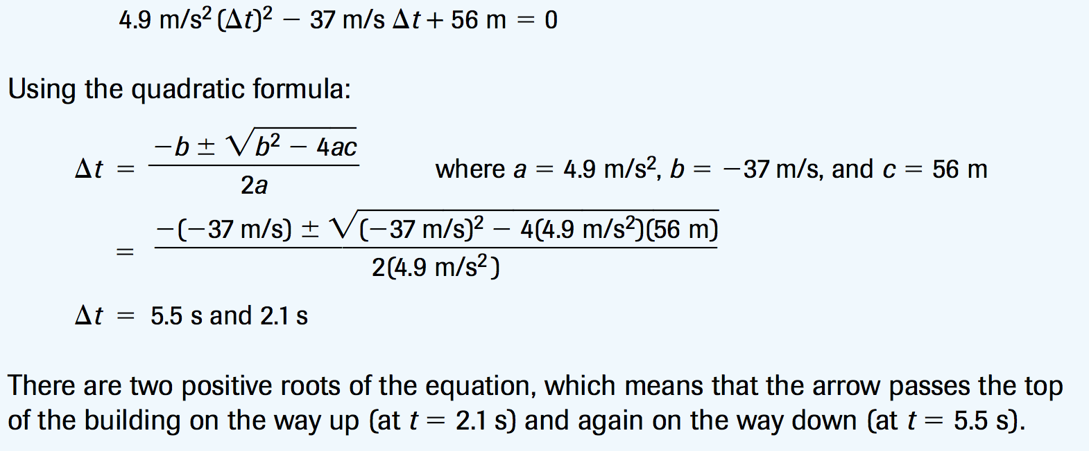
Check Your Understanding Solution

Slide 14
Air Resistance

Slide 15
Does mass affect g?
No, a larger downward force is negated by a larger mass. Both objects will accelerate towards Earth at ~10 m/s²

Slide 16
Does shape/density matter?
What falls faster? Let’s try it.

Slide 17
Calculate
Calculate the accelerations experienced by the objects observed.
Which object experienced the greatest acceleration? Which had the least?
Why did they not fall at 9.8 m/s² [downward]?

Slide 19
Air Resistance
An object that is falling through the atmosphere is subjected to two external forces.
The first force is the gravitational force (F_{grav} ), expressed as the weight of the object.
The second force is the aerodynamic drag of the object (air resistance = F_{air}) which acts in the opposite direction.
Air resistance is determined by air pressure on the surface area of the object. More surface area = more resistance
If you spread your arms while falling, you increase your surface area and slow down

Slide 20
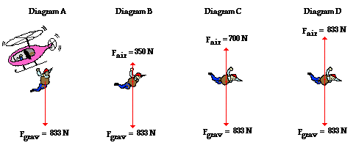
Air Resistance
Which diagram shows the greatest acceleration?

Slide 21
Air Resistance
Which diagram shows the greatest acceleration?
= Diagram A
When F_{grav} = F_{air}, acceleration = 0
Why does F_{air} increase from left to right?

Slide 22
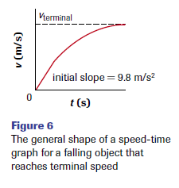
Terminal Speed

Slide 23
Terminal Speed
Why does acceleration decrease (v doesn’t increase as fast) as you fall?
F down is constant, F up increases until they equal. Why? Pressure (force/area) increases as you accelerate because more air molecules need to be pushed aside per unit time. Without air, your acceleration would be constant

Slide 24
This person is experiencing no acceleration and therefore has reached their Terminal Speed.
The Terminal Speed for an average skydiver with their parachute closed is ~ 190 km/h
More mass equals a higher terminal speed because F_{grav} is larger (m x g)

Slide 25
Check Your Understanding
The acceleration of a skydiver of mass 80 kg changes from 9.8 m/s² to 5.8 m/s² as he falls through the air. What is the air resistance experienced by him?
A sail boat is moving with an acceleration of 5 m/s². Upon encountering air resistance, its acceleration changes to 3 m/s². What is the magnitude of the force due to air resistance if the mass of the sail boat is 1500 kg?
Sam is skating down a slope experiencing a force due to gravity of 700 N. He experiences a force due to air resistance of 50 N in the opposite direction of his motion. What is his acceleration if his mass is 70 kg?
Alyssa is skateboarding down a sloped ramp. The effective gravitational force acting on her is 600 N. She also experiences a force due to air resistance of 60 N opposing her motion down the ramp. What is her acceleration if her mass is 50 kg?

Slide 26
Check Your Understanding Solutions
320 N
3000 N
9.28 m/s²
10.8 m/s²

Slide 27
Practice
Acceleration due to gravity worksheet

